Slide 1


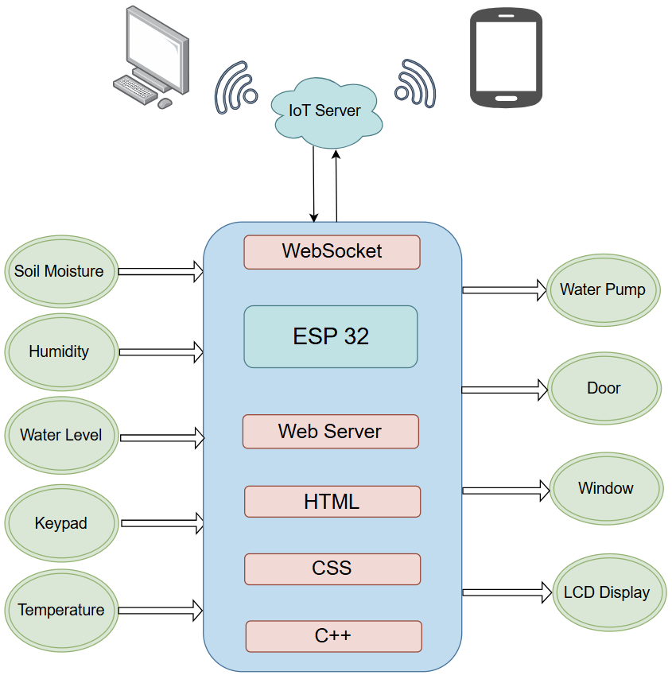
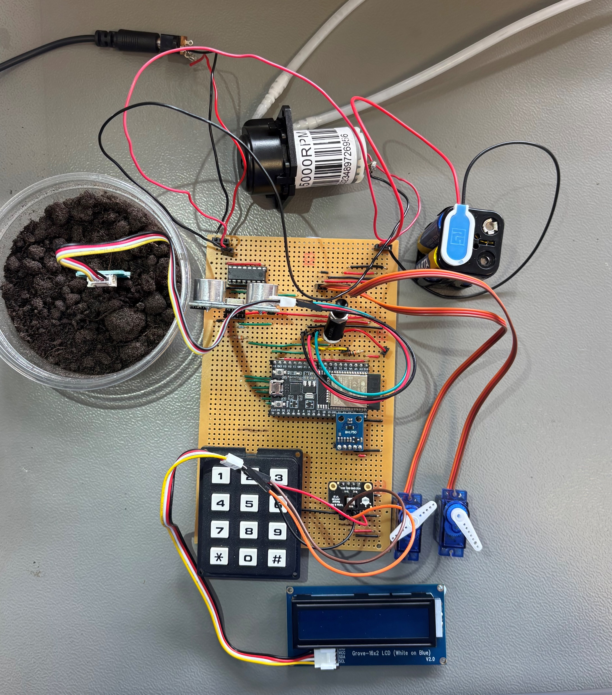





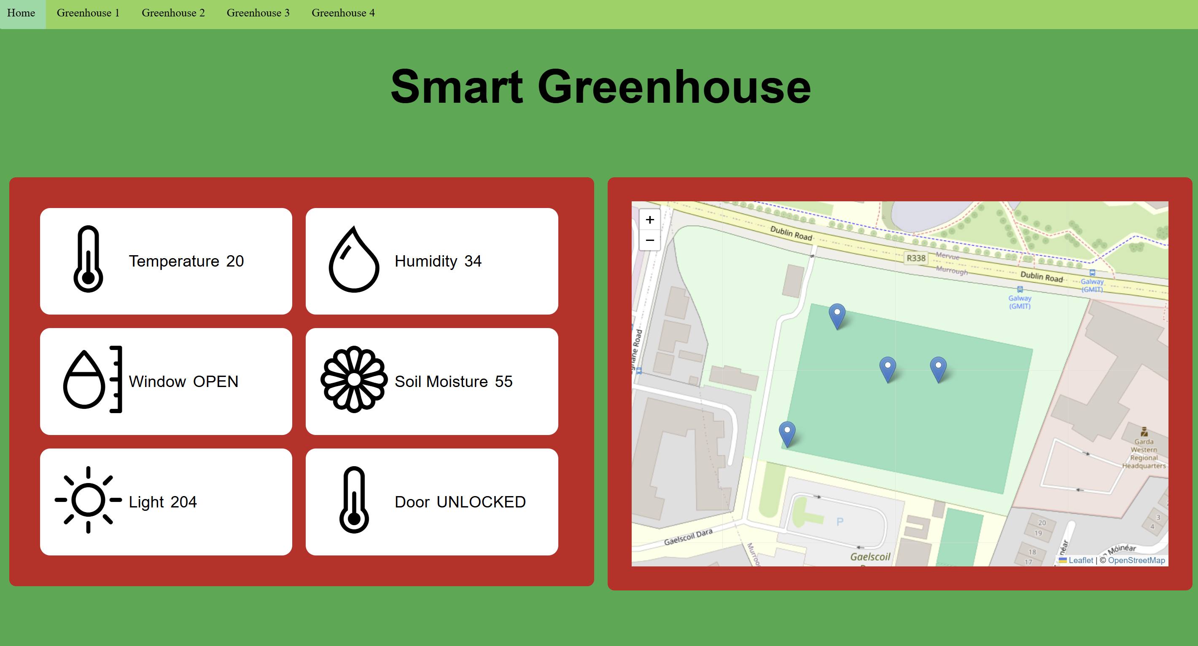

Smart Greenhouse
Marta Prieto
B.Eng. (Honours) in Software and Electronic Engineering
Header
Description and Features
Architecture Diagram
Stripboard
Innovation in agriculture has become increasingly important as we continue to face challenges like global warming and food scarcity. Over 600 million people worldwide are projected to face hunger in 2030. The Smart Greenhouse uses modern technology to solve this problem.
Features
Environment Monitoring
Temperature
Humidity
Soil Moisture
Light
PHOTO
Stripboard Photo
Self-Regulation
Automated Watering
Humidity Control
Sustainable Development Goals
The Smart Greenhouse meets several of the UN Sustainable Development Goals, I have chosen to focus on 5 of them.
The simplification of agricultural monitoring allows farmers to plant a wide range of crops, for both profit and self-sufficiency. The wide availability of healthy produce reduces reliance on expensive imports and encourages farm-to-table cooking.
As production increases, it opens the door to the possibility of exportation, encouraging economic growth and provides jobs in the local area.
Website
Skills and Technologies
Visual Studio Code
Arduino IDE
GitHub
W3 Schools
Draw.io
C/C++ Programming
Schematic Design
HTML/CSS/JavaScript
Data Analysis
Visual Studio Code
Header icon from flaticons.com

